Slide 1
So much data

Slide 2
Tomatoes -170 lb N credit
50/50 ground/surface water
500 foot deep well
64 inches water applied via flood irrigation (70% efficient, meaning 91 inches of water was pumped),
50 psi pump
diesel irrigation pump
3 year stand life
9 harvests
11 tractor passes per year

Slide 4
Tulare is driven by irrigation
Imperial is driven by field passes
Siskiyou is just low input

Slide 5
18 ‘Situations’ explored, changes from base scenario
1 | All ground water
2 | All surface water
3 | Deficit irrigation
4 | Stand life extension
5 | Double pump pressure
6 | Double well depth
7 | Eliminate pesticides
8 | Electrify irrigation
9 | Electrify harvest operations
10 | Electrify field operations
11 | Change from flood/sprinkler irrigation to drip irrigation
12 | Eliminate insecticides
13 | Eliminate herbicides
14 | Surface water, gravity fed irrigation (no irrigation energy used)
15 | No leaching-derived N2O emissions
16 | Pasture carbon credit
17 | No carbon credit
18 | Eliminate fertilizer offset

Slide 9
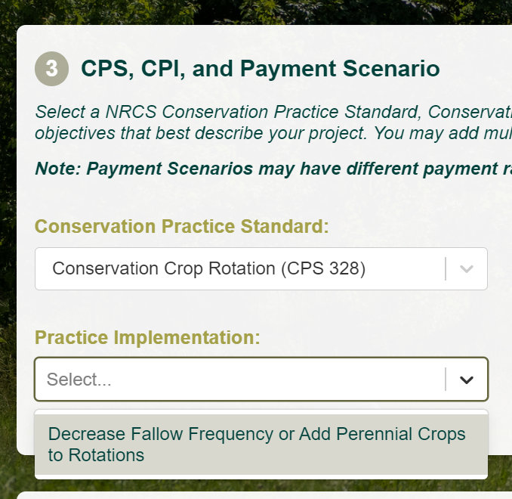
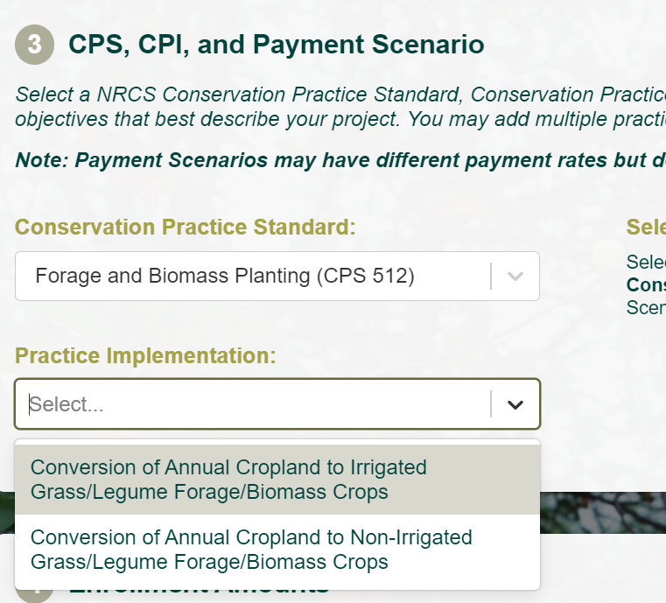
Carbon credit ranges

Slide 11
Tulare is driven by irrigation
Imperial driven by field passes

